Slide 1
Blessings
#Blessed
#FeelingBlessed
#Blessed24/7
#TheBlessedLife

Slide 2
What is a Blessing?
Who really gets and deserves a blessing?
How has God blessed your life?
How can we get more blessings?

Slide 3
What is a blessing?
What does it mean to be blessed?
What does the world think?
  #Blessed

Slide 4
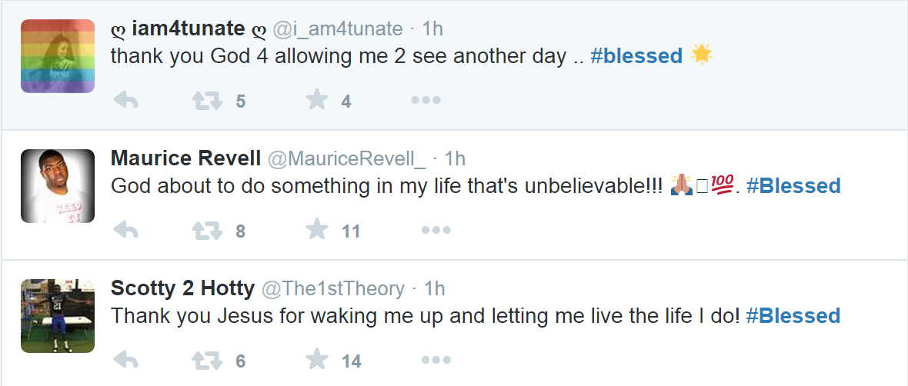

Slide 5
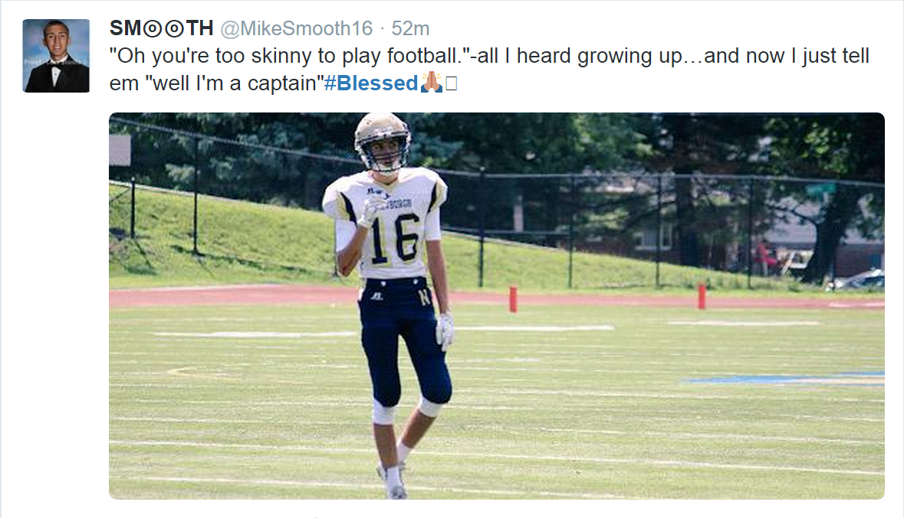

Slide 6
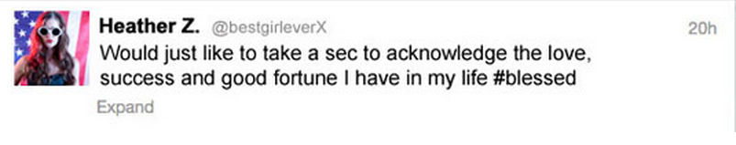
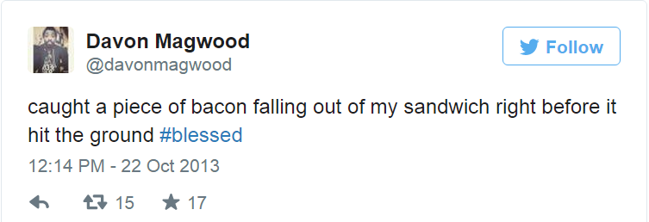

Slide 7
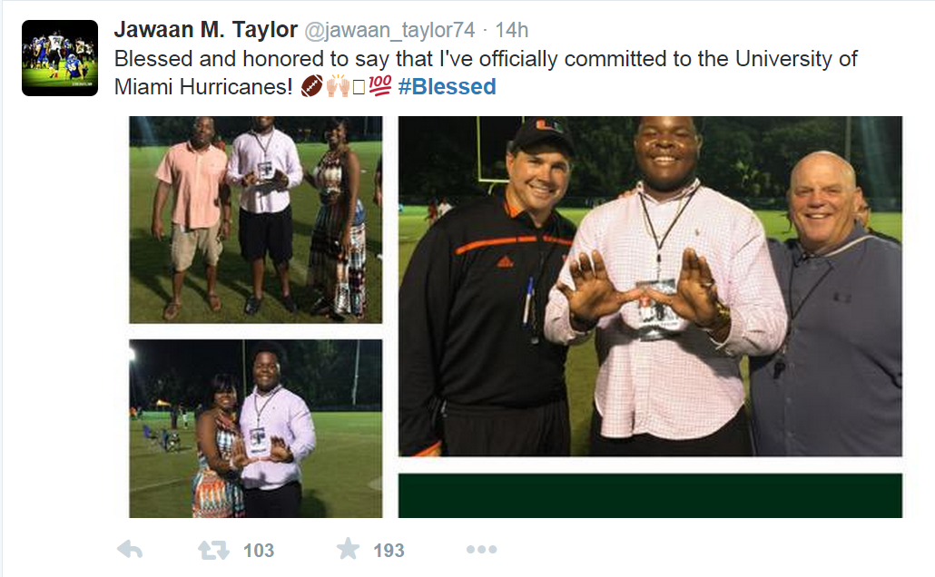

Slide 8
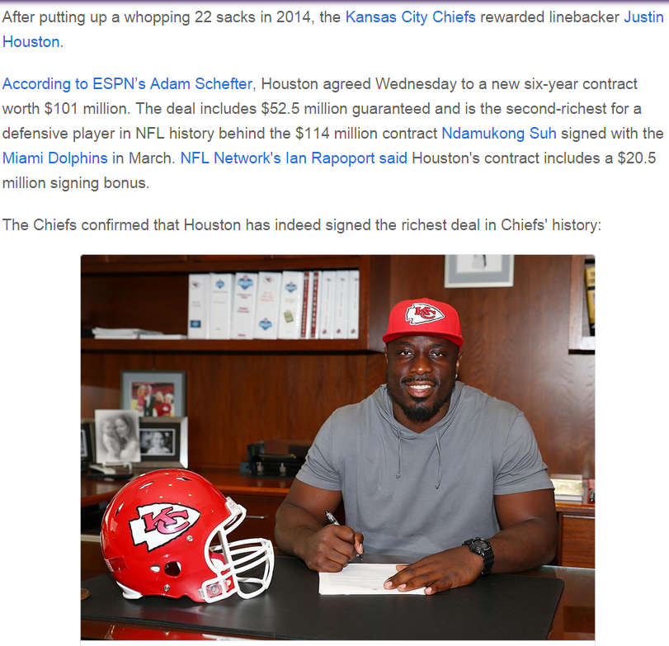
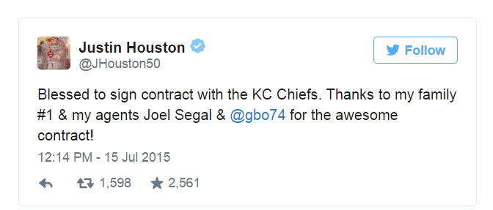

Slide 9
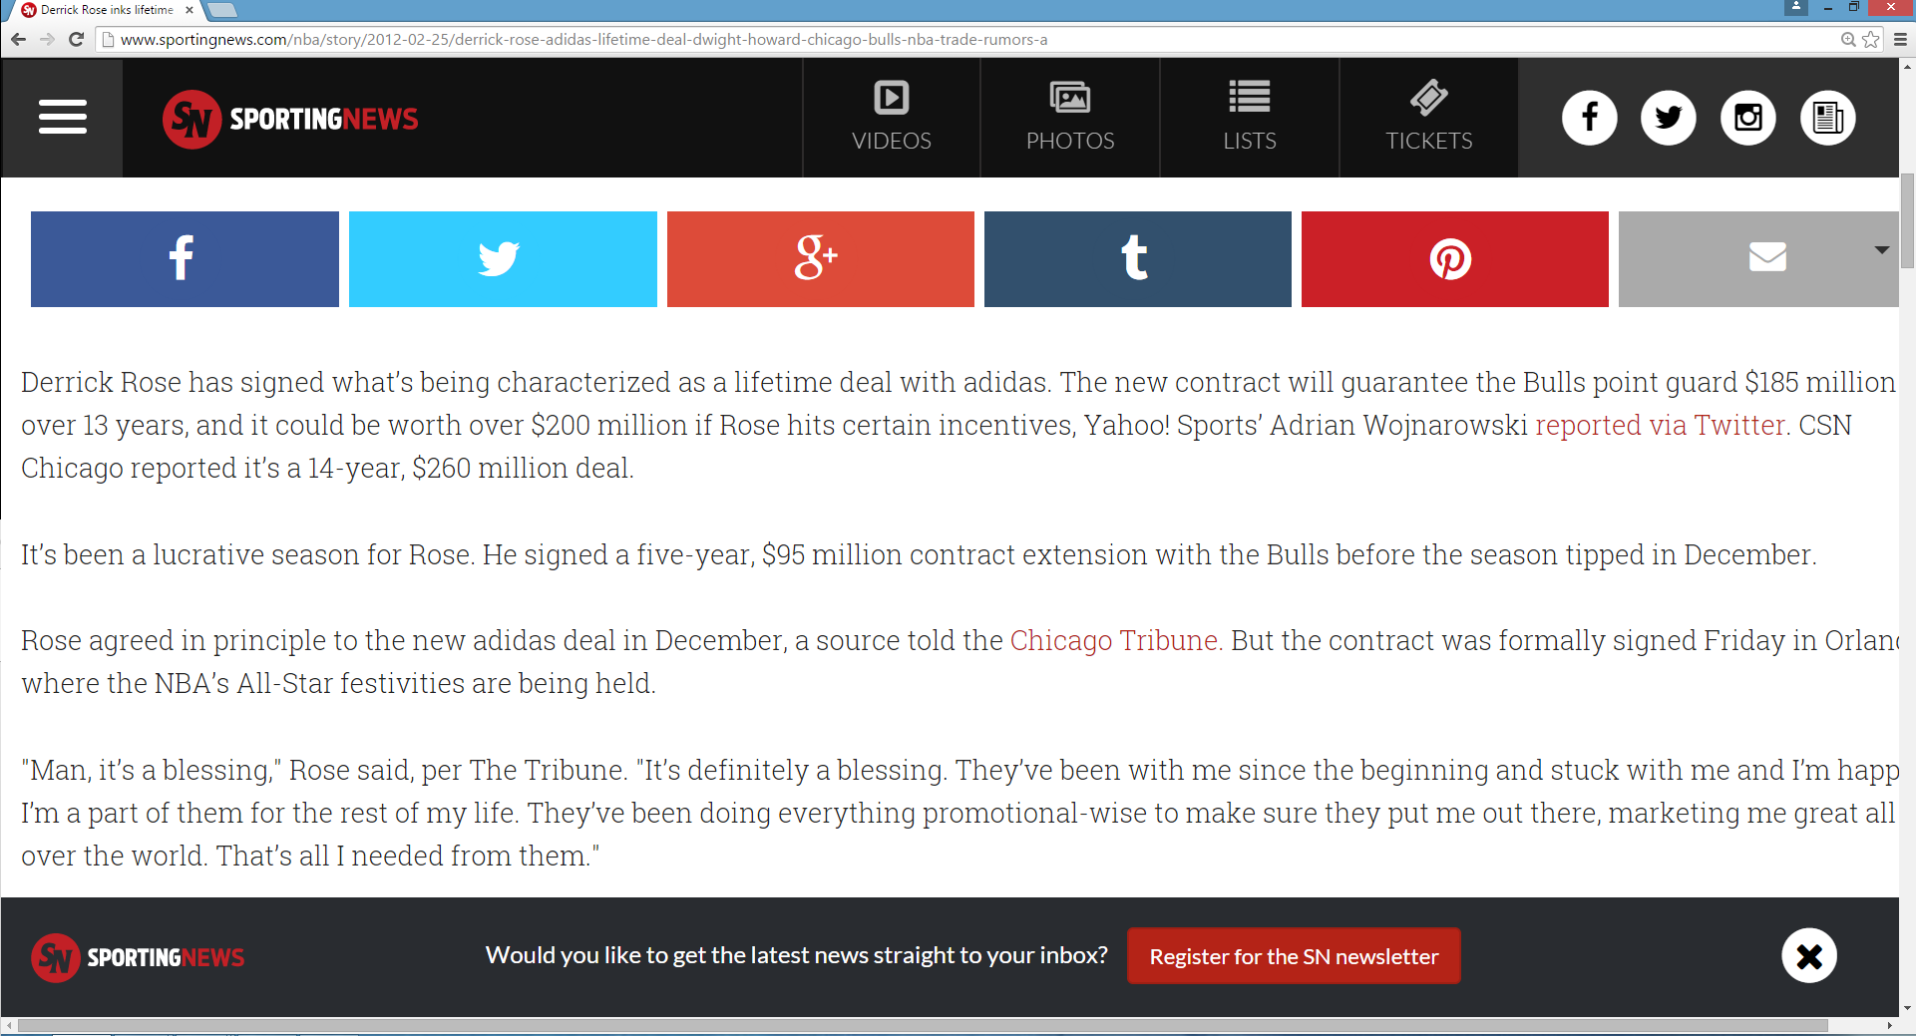

Slide 10
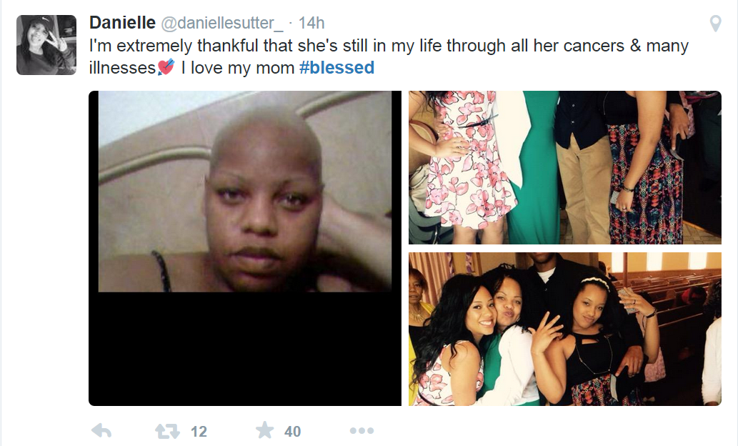

Slide 11
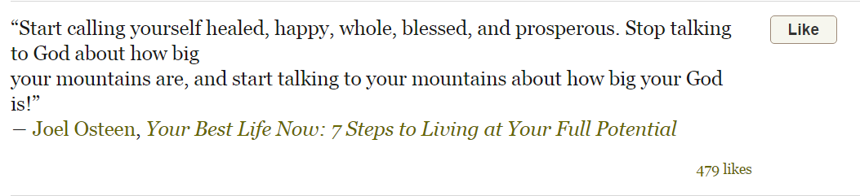

Slide 12
When is the world “blessed”?
  when they get jobs
  when they get an article in the newspaper
  when they get recognition or an award
  when they can relax on vacation
  when they have children
  when they don’t sustain injury in a car crash
  when they are alive, blessed to be breathing.
Where has God blessed your life?
  Its trendy now to be blessed.
What about Churches and Christians?

Slide 13
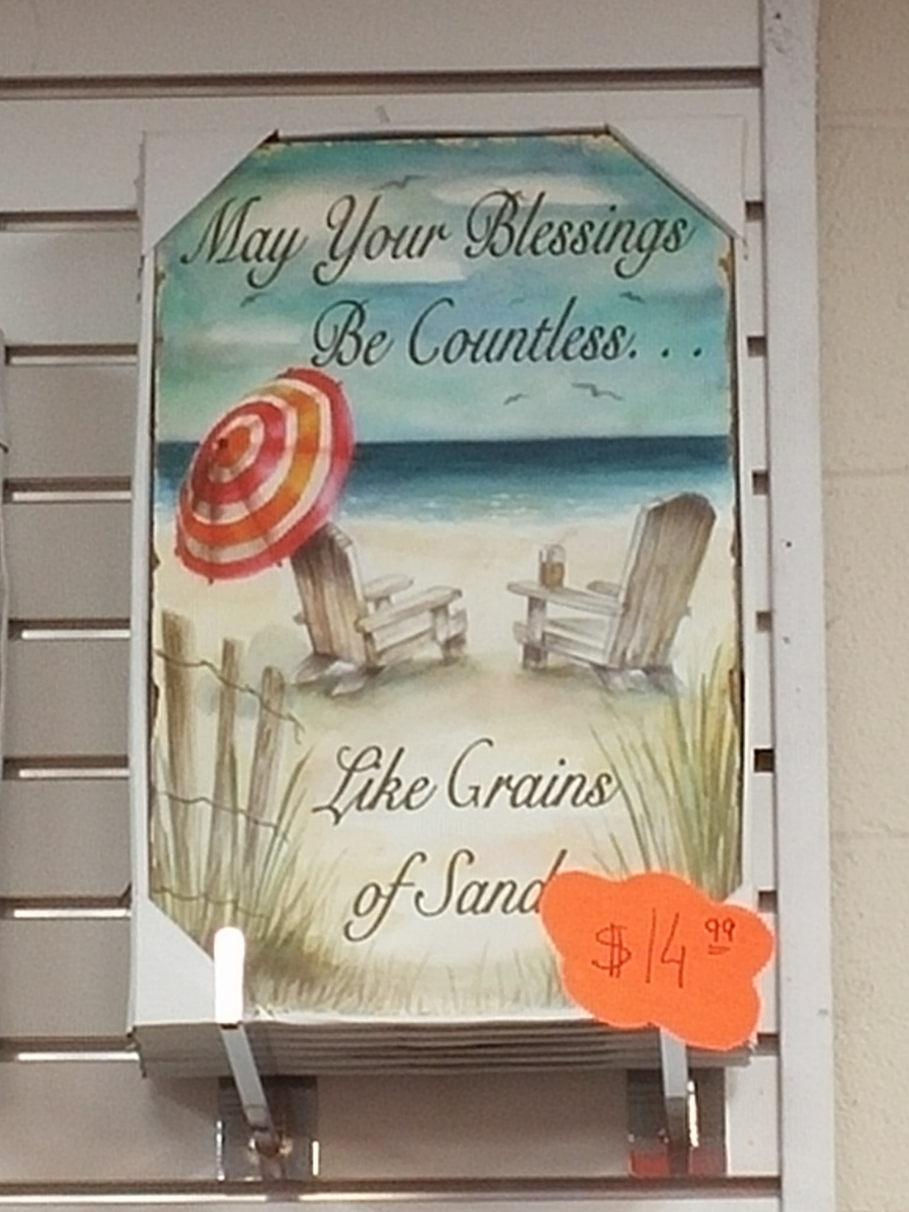

Slide 14
What about actual Christians?
What do churches believe about blessings?
  Health, wealth, prosperity.
  We ask for showers of blessings.
  We count our blessings. “Count your many blessings, see what God hath done”
  We identify “blessings in disguise”
1 Peter 3:9 Not rendering evil for evil, or railing for railing: but contrariwise blessing; knowing that ye are thereunto called, that ye should inherit a blessing.
Proverbs 28:20 A faithful man shall abound with blessings: but he that maketh haste to be rich shall not be innocent.
  Its easy for us to condemn Joel Osteen, but are we (churches) that different?
Proverbs 10:7 The memory of the just is blessed: but the name of the wicked shall rot.

Slide 15
What Does Scripture Have to Say?
  Over 450 instances of bless, blessed, or blessing in the Bible.

Slide 16
Genesis 1:21-22 And God created great whales, and every living creature that moveth, which the waters brought forth abundantly, after their kind, and every winged fowl after his kind: and God saw that it was good. 22 And God blessed them, saying, Be fruitful, and multiply, and fill the waters in the seas, and let fowl multiply in the earth.
Genesis 12:1-2 Now the LORD had said unto Abram, Get thee out of thy country, and from thy kindred, and from thy father's house, unto a land that I will shew thee: 2 And I will make of thee a great nation, and I will bless thee, and make thy name great; and thou shalt be a blessing:
  No one in the Bible that God blessed more than Abraham.
  When God blesses, he makes you great, and respected, and honored!!
  Lebron James is blessed, his name is great.

Slide 17
Genesis 28:1,3-4 And Isaac called Jacob, and blessed him, … 3 And God Almighty bless thee, and make thee fruitful, and multiply thee, that thou mayest be a multitude of people; 4 And give thee the blessing of Abraham, to thee, and to thy seed with thee; that thou mayest inherit the land wherein thou art a stranger, which God gave unto Abraham.
Genesis 27:27 And he came near, and kissed him: and he smelled the smell of his raiment, and blessed him, and said, See, the smell of my son is as the smell of a field which the LORD hath blessed:
Genesis 27:28 Therefore God give thee of the dew of heaven, and the fatness of the earth, and plenty of corn and wine:
Genesis 27:29 Let people serve thee, and nations bow down to thee: be lord over thy brethren, and let thy mother's sons bow down to thee: cursed be every one that curseth thee, and blessed be he that blesseth thee.

Slide 18
Genesis 26:12-14 Then Isaac sowed in that land, and received in the same year an hundredfold: and the LORD blessed him. 13 And the man waxed great, and went forward, and grew until he became very great: 14 For he had possession of flocks, and possession of herds, and great store of servants: and the Philistines envied him.
  Here is a blessing from God. Possessions and servants, and bountiful fruits!
  When God blesses, he makes you fruitful, and multiplied, and rich in possessions, land, children!!
  Your enemies envy you! This is a blessing. Isaac was blessed 24/7!!!
  To bless seems to be to cause to increase or bring forth in abundance. To be made great, a ruler, given power or wealth.
  Well, guess what? Apparently, the world is right!!!

Slide 19
DEFINITION 1: Something that makes your life better, makes you happy. (A blessing that you receive).
  E.g. “My parents blessed me with a good education.”
    So that you can get a good job or succeed.
  An object or thing in this world.
Joshua 15:18-19 And it came to pass, as she came unto him, that she moved him to ask of her father a field: and she lighted off her ass; and Caleb said unto her, What wouldest thou? 19 Who answered, Give me a blessing; for thou hast given me a south land; give me also springs of water. And he gave her the upper springs, and the nether springs.
2 Kings 5:15 And he returned to the man of God, he and all his company, and came, and stood before him: and he said, Behold, now I know that there is no God in all the earth, but in Israel: now therefore, I pray thee, take a blessing of thy servant.

Slide 20
  Could be children, land, health, riches, food, admiration/respect/recognition. Something that makes your life better or happier.
  When God blesses a man or woman, its everywhere.
Deuteronomy 7:13-14 And he will love thee, and bless thee, and multiply thee: he will also bless the fruit of thy womb, and the fruit of thy land, thy corn, and thy wine, and thine oil, the increase of thy kine, and the flocks of thy sheep, in the land which he sware unto thy fathers to give thee. 14 Thou shalt be blessed above all people: there shall not be male or female barren among you, or among your cattle.
  The blessing on the nation of Israel if they served God only.
  A increase in family, possessions, recognition, or power.
  Not necessarily so in scripture, but the implication today is that it is God-given.
    Churches: “Count your many blessings, see what God hath done”
    The World: “May your blessings be countless, as grains of sand”
    Ever heard an atheist say that they are blessed? Well apparently anyone can bless you.

Slide 21
  “I am blessed”, often means “God blessed me”.
    I believe in God, I’m on good terms with God, and he did this.
    And it’s these references that I took issue with.
  Even if I wanted to, according to scripture I can’t disagree.
1 Chronicles 4:10 And Jabez called on the God of Israel, saying, Oh that thou wouldest bless me indeed, and enlarge my coast, and that thine hand might be with me, and that thou wouldest keep me from evil, that it may not grieve me! And God granted him that which he requested.
  Give me an easy life, let me not be grieved by evil things.
  How would we know if God is really blessing them?
    The only way to know is to look at how God blesses in the Bible.
  The opposite then would be a curse. Something that makes your life worse.
Genesis 4:11-12 And now art thou cursed from the earth, which hath opened her mouth to receive thy brother's blood from thy hand; 12 When thou tillest the ground, it shall not henceforth yield unto thee her strength; a fugitive and a vagabond shalt thou be in the earth.

Slide 22
DEFINITION 2: To give thanks, praise, and honor or to give good wishes, good will, or approval towards. (A blessing that you impart)
  “Our boss blessed the contract document.”
  “Our boss cursed the contract document.”
2 Samuel 13:25 And the king said to Absalom, Nay, my son, let us not all now go, lest we be chargeable unto thee. And he pressed him: howbeit he would not go, but blessed him.
  Absalom invited King David to his feast, David says, no but thank you, good luck, have fun, you have my blessing, my approval.
1 Corinthians 14:16 Else when thou shalt bless with the spirit, how shall he that occupieth the room of the unlearned say Amen at thy giving of thanks, seeing he understandeth not what thou sayest?

Slide 23
DEFINITION 3: Sanctified, devoted to God.
  Blessed the temple and the things in it.
  Cursed would mean corrupted, devoted to destruction. Fitted for destruction.
2 Peter 2:12,14 But these, as natural brute beasts, made to be taken and destroyed, speak evil of the things that they understand not; and shall utterly perish in their own corruption; 14 Having eyes full of adultery, and that cannot cease from sin; beguiling unstable souls: an heart they have exercised with covetous practices; cursed children:

Slide 24
Deuteronomy 28:1 And it shall come to pass, if thou shalt hearken diligently unto the voice of the LORD thy God, to observe and to do all his commandments which I command thee this day, that the LORD thy God will set thee on high above all nations of the earth:
Deuteronomy 28:2 And all these blessings shall come on thee, and overtake thee, if thou shalt hearken unto the voice of the LORD thy God.
Deuteronomy 28:3 Blessed shalt thou be in the city, and blessed shalt thou be in the field.
Deuteronomy 28:4 Blessed shall be the fruit of thy body, and the fruit of thy ground, and the fruit of thy cattle, the increase of thy kine, and the flocks of thy sheep.
Deuteronomy 28:5 Blessed shall be thy basket and thy store.

Slide 25
Deuteronomy 28:6 Blessed shalt thou be when thou comest in, and blessed shalt thou be when thou goest out.
Deuteronomy 28:7 The LORD shall cause thine enemies that rise up against thee to be smitten before thy face: they shall come out against thee one way, and flee before thee seven ways.
Deuteronomy 28:8 The LORD shall command the blessing upon thee in thy storehouses, and in all that thou settest thine hand unto; and he shall bless thee in the land which the LORD thy God giveth thee.
Deuteronomy 28:9 The LORD shall establish thee an holy people unto himself, as he hath sworn unto thee, if thou shalt keep the commandments of the LORD thy God, and walk in his ways.
Deuteronomy 28:10 And all people of the earth shall see that thou art called by the name of the LORD; and they shall be afraid of thee.

Slide 26
Deuteronomy 28:11 And the LORD shall make thee plenteous in goods, in the fruit of thy body, and in the fruit of thy cattle, and in the fruit of thy ground, in the land which the LORD sware unto thy fathers to give thee.
Deuteronomy 28:12 The LORD shall open unto thee his good treasure, the heaven to give the rain unto thy land in his season, and to bless all the work of thine hand: and thou shalt lend unto many nations, and thou shalt not borrow.
Deuteronomy 28:13 And the LORD shall make thee the head, and not the tail; and thou shalt be above only, and thou shalt not be beneath; if that thou hearken unto the commandments of the LORD thy God, which I command thee this day, to observe and to do them:
Deuteronomy 28:14 And thou shalt not go aside from any of the words which I command thee this day, to the right hand, or to the left, to go after other gods to serve them.

Slide 27
Deuteronomy 28:15 But it shall come to pass, if thou wilt not hearken unto the voice of the LORD thy God, to observe to do all his commandments and his statutes which I command thee this day; that all these curses shall come upon thee, and overtake thee:
Deuteronomy 28:16 Cursed shalt thou be in the city, and cursed shalt thou be in the field.
Deuteronomy 28:17 Cursed shall be thy basket and thy store.
Deuteronomy 28:18 Cursed shall be the fruit of thy body, and the fruit of thy land, the increase of thy kine, and the flocks of thy sheep.
Deuteronomy 28:19 Cursed shalt thou be when thou comest in, and cursed shalt thou be when thou goest out.
  The promise to Israel: essentially, do right and you’ll be blessed (good prosperous life), do wrong and you will be cursed (bad poor life).

Slide 28
BREAK
---------------
Pick Up Here

Slide 29
The world says that a blessing is anything that makes your life better.
Churches say the same.
I wanted to say, “No, its not”… but they were right.
Blessings are good things that make your life easier, happier, better.
A few questions for us to answer:
  We look for showers of blessings, and we are taught to count our blessings. Should we?
  How can we get or earn blessings from God?

Slide 30
Leviticus 25:21 Then I will command my blessing upon you in the sixth year, and it shall bring forth fruit for three years.
  A blessing that God gives is about increase, about fruit.
    Fruit of womb, fruit of land.
Genesis 4:11-12 And now art thou cursed from the earth, which hath opened her mouth to receive thy brother's blood from thy hand; 12 When thou tillest the ground, it shall not henceforth yield unto thee her strength; a fugitive and a vagabond shalt thou be in the earth.
Deuteronomy 15:4 Save when there shall be no poor among you; for the LORD shall greatly bless thee in the land which the LORD thy God giveth thee for an inheritance to possess it:

Slide 31
Exodus 23:25 And ye shall serve the LORD your God, and he shall bless thy bread, and thy water; and I will take sickness away from the midst of thee.
    When God blesses, you are not poor, you have health, food, riches, children, and respect, and everything good this life has to offer.
    Well then, the world, and even many Christians are blessed 24/7.
    But is it of God? If God was blessing you, you wouldn’t even get sick!
Proverbs 10:7 The memory of the just is blessed: but the name of the wicked shall rot.
  Whose names are preserved? The heroes, the talented. Michael Jordan. Michael Jackson. child molestation. Wouldn’t he think he was blessed? Robin Williams, suicide. What a blessed life. What a blessing to have so much love?!?!
  I have family and friends, and a good life, I must be blessed by God.
  Well aren’t they blessed? YES, BUT is the blessing of God?
  Ahh… but serious problems arise when we take promises made to Israel and apply them to the Church/Christian.
  Lets take a took at the New Testament…

Slide 32
What Does Scripture Have to Say in the New Testament?
  105 instances of bless, blessed, or blessing in the NT
  which is about the same ratio of instances per verse.

Slide 33
Matthew 5:3 Blessed are the poor in spirit: for theirs is the kingdom of heaven.
  The first time the word blessed is used in the NT.
  Now, it’s not just poor. There is plenty of poor.
Isaiah 66:2 For all those things hath mine hand made, and all those things have been, saith the LORD: but to this man will I look, even to him that is poor and of a contrite spirit, and trembleth at my word.
  You have to give up all, become poor and hungry and sorrowful and humbled IN SPIRIT.
  Nonetheless, the concept is completely changed. The first time we see blessed people, they are not rich, but poor!
Matthew 5:4 Blessed are they that mourn: for they shall be comforted.
  God doesn’t bless with comfort on Earth today.
  He blesses those that mourn, and their comfort is not given here.
  We do get comfort and refreshment from friends and family, especially Christian brothers/sisters. But comfort is not called a blessing in the NT.

Slide 34
Matthew 5:5 Blessed are the meek: for they shall inherit the earth.
  The meek will inherit the earth. The definition of blessing is the same: riches, land, etc.
  Who of the richest most powerful people on earth are gentle? (Trump?)
    It’s the when that has changed.
  But its not on the meek in flesh, the poor in flesh. Not going to be made rich because they are good and gentle people.
Matthew 5:6 Blessed are they which do hunger and thirst after righteousness: for they shall be filled.
  God makes no promise to end poverty and hunger. Its not here on earth!
  Family in our neighborhood held this sentiment.
  Not just the hungry. The hungry in spirit, the poor in spirit, the meek in spirit. (1Pet 3:4)
Matthew 5:7 Blessed are the merciful: for they shall obtain mercy.
Matthew 5:8 Blessed are the pure in heart: for they shall see God.

Slide 35
Matthew 5:9 Blessed are the peacemakers: for they shall be called the children of God.
  Who are the peacemakers?
Ephesians 2:15 Having abolished in his flesh the enmity, even the law of commandments contained in ordinances; for to make in himself of twain one new man, so making peace;
James 3:18 And the fruit of righteousness is sown in peace of them that make peace.
Matthew 5:10 Blessed are they which are persecuted for righteousness' sake: for theirs is the kingdom of heaven.
  A big change!!
  Blessed were the blessed. Now, the blessed are the cursed, the persecuted.
  Not just the poor, not just the persecuted, the persecuted for righteousness’ sake.
  There is a change in who blessings are upon.
    Not the winners or the violent anymore.

Slide 36
Matthew 5:11 Blessed are ye, when men shall revile you, and persecute you, and shall say all manner of evil against you falsely, for my sake.
  Again, not just reviled and persecuted, but “for my sake”.
  My name should be great, I shouldn’t be reviled, despised.
  It will be great. Just hang on..
Matthew 5:12 Rejoice, and be exceeding glad: for great is your reward in heaven: for so persecuted they the prophets which were before you.
  Blessing is making my life better!
  There is a change in when blessings are received.
  We’re still going to inherit the earth and our names will be made great.
  But the blessings are no longer given by God in THIS LIFE!
Ephesians 1:3 Blessed be the God and Father of our Lord Jesus Christ, who hath blessed us with all spiritual blessings in heavenly places in Christ:

Slide 37
1 Peter 3:9 Not rendering evil for evil, or railing for railing: but contrariwise blessing; knowing that ye are thereunto called, that ye should inherit a blessing.
Colossians 3:24 Knowing that of the Lord ye shall receive the reward of the inheritance: for ye serve the Lord Christ.
  We have not received the inheritance. But we shall!!
  Just a few more days, weeks, years?
1 Peter 1:4 To an inheritance incorruptible, and undefiled, and that fadeth not away, reserved in heaven for you,
  Well that’s disappointing, no?
Luke 6:23 Rejoice ye in that day, and leap for joy: for, behold, your reward is great in heaven: for in the like manner did their fathers unto the prophets.

Slide 38
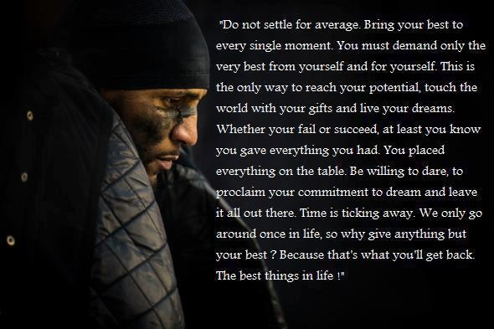
Galatians 6:8 For he that soweth to his flesh shall of the flesh reap corruption; but he that soweth to the Spirit shall of the Spirit reap life everlasting.

Slide 39
Luke 11:27-28 And it came to pass, as he spake these things, a certain woman of the company lifted up her voice, and said unto him, Blessed is the womb that bare thee, and the paps which thou hast sucked. 28 But he said, Yea rather, blessed are they that hear the word of God, and keep it.
  It did bring forth God in the flesh. It was blessed.
  Every person that met Mary must have respected her. Highly favoured.
    And now people worship her!
  Jesus had to change our understanding
    Who the blessed are.
    When and where the blessings are given.
  But that’s not the real blessing anymore. We have access to a much better blessing.

Slide 40
Mark 12:14-17 And when they were come, they say unto him, Master, we know that thou art true, and carest for no man: for thou regardest not the person of men, but teachest the way of God in truth: Is it lawful to give tribute to Caesar, or not? 15 Shall we give, or shall we not give? But he, knowing their hypocrisy, said unto them, Why tempt ye me? bring me a penny, that I may see it. 16 And they brought it. And he saith unto them, Whose is this image and superscription? And they said unto him, Caesar's. 17 And Jesus answering said unto them, Render to Caesar the things that are Caesar's, and to God the things that are God's. And they marvelled at him.
  Wars are fought over this simple question. Men see no possible answer.
  They marveled at something this simple:
    That is not our fight, our war.
    Your blessings are not here. Your rewards/riches are not to be taken on this earth.
  We are seeking to make our world, and even the world, a better place (nurses/doctors).
  But we are still seeking a good and an easy life (patio). We should be seeking the opposite.

Slide 41
2 Timothy 2:12 If we suffer, we shall also reign with him: if we deny him, he also will deny us:
2 Timothy 2:13 If we believe not, yet he abideth faithful: he cannot deny himself.
2 Timothy 2:14 Of these things put them in remembrance, charging them before the Lord that they strive not about words to no profit, but to the subverting of the hearers.
  What things? That we are not to be blessed here, but cursed!
  Think about Obamacare, gay rights, gun control, any social issue or argument that includes two polar opposites of opinion on what is right and what will make our world and lives better.
    We are fighting to make this world better! What should we strive to improve?
  What about religious freedom, should we fight for that?
    When we fought for religious freedom and won it, we LOST the rewards for many!
    We took away our blessings that are given for suffering for His sake!
    Founding fathers were ignorant and weak Christians. They ran from God’s will. (And we are too.)
    Those that are beheaded for Christ in revelation live and reign with him for a thousand years.

Slide 42
Break Here
The world says work hard for the best things in life.
The churches say ask for showers of blessings, and count them all.

Slide 43
Luke 6:20 And he lifted up his eyes on his disciples, and said, Blessed be ye poor: for yours is the kingdom of God.
  Not THE poor. YE poor.
  How can the poor be blessed? Blessed is increased, blessed is profitable.
Luke 6:21 Blessed are ye that hunger now: for ye shall be filled. Blessed are ye that weep now: for ye shall laugh.
  Many hunger, many weep. Anyone that has lost a spouse, child, or a parent has wept.
  Who is he talking to? Disciples = Christians. Blessed are the disciples that weep now.
Luke 6:22 Blessed are ye, when men shall hate you, and when they shall separate you from their company, and shall reproach you, and cast out your name as evil, for the Son of man's sake.
  Until now, blessed have had great names, now they have evil names?
  If you want to know about blessings, here is how to get them.
  Not blessed when we possess all, and are loved of all, but when we hunger, weep, when we are hated, and separated… FOR HIS SAKE.
  OH, wait, I get it. I need to go get hated a bit before God lifts me up and gives me the blessings later.

Slide 44
Luke 6:23 Rejoice ye in that day, and leap for joy: for, behold, your reward is great in heaven: for in the like manner did their fathers unto the prophets.
  Blessed are ye that weep now, for ye shall laugh tomorrow…?
  Persecuted today, blessed tomorrow? The reward is not in this life.
  The first wont be last in this life, and poor wont be made rich in this life.
  The rich won’t become poor in this life, the full won’t hunger.
  Jesus knows we won’t want to rejoice. Consider a child on a playground.
  Not rejoice tomorrow or next year, rejoice today!!
  What is the shame in having money and nice things and taking joy in them?
Luke 6:24 But woe unto you that are rich! for ye have received your consolation.
  You that are rich, that are blessed in this life!
  You that are blessed 24/7. I wanted to say “no you are not”.
  But in fact, “yes, you are. Enjoy it now, ‘for ye have received your consolation’”.

Slide 45
Luke 16:13 No servant can serve two masters: for either he will hate the one, and love the other; or else he will hold to the one, and despise the other. Ye cannot serve God and mammon.
Luke 16:14 And the Pharisees also, who were covetous, heard all these things: and they derided him.
Luke 16:25 But Abraham said, Son, remember that thou in thy lifetime receivedst thy good things, and likewise Lazarus evil things: but now he is comforted, and thou art tormented.
  I don’t know that I understand all of this fully doctrinally.
  I do know that Jesus was preaching the gospel of the kingdom, a different gospel.
  The Jews were lifting themselves up and valuing money, possessions, etc.
  Jesus taught this story for them, his disciples, and even us, to understand this basic concept: You take your consolation (reward) in this life, or in the next. Not both.
  Why didn’t the Jews understand and believe Jesus? Because they were familiar with the law.

Slide 46
Luke 6:25 Woe unto you that are full! for ye shall hunger. Woe unto you that laugh now! for ye shall mourn and weep.
  I’m alive, I have family, and food, and friends, and joy, and laughter. My life is blessed.
  And this concept goes for the Christian too.
    If you get rewards and consolation and the best things in life…
    If you are living for life and laughter and love and joy, you are going to weep at the judgement.
  Go ahead and take your rewards now.
Luke 6:26 Woe unto you, when all men shall speak well of you! for so did their fathers to the false prophets.
Luke 6:27 But I say unto you which hear, Love your enemies, do good to them which hate you,
  He is talking to YOU WHICH HEAR!
  He’s not talking to those in the OT, he’s not talking to unsaved people today –THE POOR.
  He’s talking to his disciples, preaching the gospel of the kingdom.
  I believe this is still true for the Church, as it lines up with Paul’s preaching.

Slide 47
Luke 6:27-28 But I say unto you which hear, Love your enemies, do good to them which hate you, 28 Bless them that curse you, and pray for them which despitefully use you.
  Those that make your life worse… make theirs better.
  Pray for them which use us?
  What did Jesus pray for them? Forgive them father, for they know not what they do!!
Luke 6:29 And unto him that smiteth thee on the one cheek offer also the other; and him that taketh away thy cloke forbid not to take thy coat also.
Luke 6:30 Give to every man that asketh of thee; and of him that taketh away thy goods ask them not again.
  Do these verses apply to the church?
    But Jesus has said, no more violence. Paul says to suffer (allow) persecutions.
    We have been striving to protect ourselves and our possessions.
    This sermon teaches fundamental truths about this life vs. the next which have been and will be true since John the Baptist and Jesus walked the earth.

Slide 48
Luke 6:31 And as ye would that men should do to you, do ye also to them likewise.
  I wish when I stole something I didn’t get arrested for it.
  I wish I didn’t have to give back what I borrowed.
  I wish when I punched someone, they didn’t punch back.
  WHY? Is it to win the lost?
Luke 6:32 For if ye love them which love you, what thank have ye? for sinners also love those that love them.
  No, its because we get blessings and thanks for suffering as Jesus did.
Luke 6:33 And if ye do good to them which do good to you, what thank have ye? for sinners also do even the same.
Luke 6:34 And if ye lend to them of whom ye hope to receive, what thank have ye? for sinners also lend to sinners, to receive as much again.
  3 times: its about thanks, reward, blessing.

Slide 49
Philippians 1:29 For unto you it is given in the behalf of Christ, not only to believe on him, but also to suffer for his sake;
  Suffering is not about the lost. Its about us. And it is FOR us.
Luke 6:35 But love ye your enemies, and do good, and lend, hoping for nothing again; and your reward shall be great, and ye shall be the children of the Highest: for he is kind unto the unthankful and to the evil.
  How can I get a blessing if I’m not hoping for something back?
  My opinion: nearly every person hopes for something in return for going good. Karma.
    What about for a marriage?
    You atleast owe me a thank you, right? Well then, there is your thanks, there is your reward. God doesn’t owe you thanks. “what thank have ye”?
    Almost NOBODY has done charity.
  A great reward for charity, suffering persecution, for loving your enemy. A reward for when your enemies take advantage of you.
  Just like Job you will get two-fold, right? No.

Slide 50
Romans 12:14 Bless them which persecute you: bless, and curse not.
  Bless your enemies: wish them good. Bless them: make their lives better. Why?
  Three Reasons:
    If by any means we can win them.
    When you bless you will get a blessing back.
    Blessed in this life, Cursed in the next.
Romans 12:20 Therefore if thine enemy hunger, feed him; if he thirst, give him drink: for in so doing thou shalt heap coals of fire on his head.
  Keep piling up his blessings in this life.
  Not in hate or spite.

Slide 51
  God no longer gives blessings on the lives of the just.
  If God HAS blessed your life, you’d better rethink some things.
    Maybe someone else has blessed your life, or you have worked hard for your goods.
    But if you are calling it a blessing from God, “God is good, he’s done this, this, and this.”
  There is only one blessing from God on the Christian at this time.
Acts 3:26 Unto you first God, having raised up his Son Jesus, sent him to bless you, in turning away every one of you from his iniquities.
  Not in giving you a better life.
Revelation 14:13 And I heard a voice from heaven saying unto me, Write, Blessed are the dead which die in the Lord from henceforth: Yea, saith the Spirit, that they may rest from their labours; and their works do follow them.
  The world says, I have a great life, I’m definitely blessed!
  God says, the dead are the blessed!
  This is a complete reversal from the OT. Not in definition, but on timing and location.

Slide 52
Romans 4:6 Even as David also describeth the blessedness of the man, unto whom God imputeth righteousness without works,
Romans 4:7 Saying, Blessed are they whose iniquities are forgiven, and whose sins are covered.
Romans 4:8 Blessed is the man to whom the Lord will not impute sin.
  The saved sinner is the blessed.
  The righteousness of God is the blessing.

Slide 53
Galatians 3:14 That the blessing of Abraham might come on the Gentiles through Jesus Christ; that we might receive the promise of the Spirit through faith.
  We get the same blessing as Abraham?
Ephesians 1:14 Which is the earnest of our inheritance until the redemption of the purchased possession, unto the praise of his glory.
  The only piece of our inheritance, our blessing that we get here on Earth is the Spirit.
  And the only thing we are blessed in is our salvation.
  Your good fortune, and health, and increase of children are not blessings from God.
  Maybe they are blessings from someone else?
2 Corinthians 1:22 Who hath also sealed us, and given the earnest of the Spirit in our hearts.
  Only given us a fraction of our inheritance, our blessings.
  The fruits of the Spirit: joy, peace, love, etc.

Slide 54
1 Corinthians 4:12 And labour, working with our own hands: being reviled, we bless; being persecuted, we suffer it:
  WHY??????? One reason!
1 Peter 2:19 For this is thankworthy, if a man for conscience toward God endure grief, suffering wrongfully.
  For thanks, for blessings. We do charity for many reasons, but there is only one reason to suffer persecutions.
  When you suffer FOR HIS SAKE, then you should rejoice.
1 Corinthians 4:13 Being defamed, we intreat: we are made as the filth of the world, and are the offscouring of all things unto this day.
  We suffer it!
  There is no blessing due us in this life.
  God has not blessed your life. He’s only blessed your heart.
  When God blesses, you are not poor, you have food, riches, children, and respect, and everything good this life has to offer.
  But he’s not blessing you here, not blessing you now, and if you seem to be blessed….

Slide 55
Revelation 3:17 Because thou sayest, I am rich, and increased with goods, and have need of nothing; and knowest not that thou art wretched, and miserable, and poor, and blind, and naked:
  My life is good, I am healthy, I have family, friends, a good job, I have need of nothing. I am blessed. God has blessed me.
  “Count your many blessings, see what God hath done”
  Well then, maybe they are blessed 24/7.
  But I wouldn’t want to be the Christian who is counting his or her blessings in life.
  You’ll find you have none in your eternal life.

Slide 56
Are all bad things actually blessings?
1 Peter 4:14 If ye be reproached for the name of Christ, happy are ye; for the spirit of glory and of God resteth upon you: on their part he is evil spoken of, but on your part he is glorified.
1 Peter 4:16 Yet if any man suffer as a Christian, let him not be ashamed; but let him glorify God on this behalf.
Philippians 1:29 For unto you it is given in the behalf of Christ, not only to believe on him, but also to suffer for his sake;
  Any bad thing that comes on you because of him is a blessing.
  What about bad things that happen for no reason?
  What about bad things that happen as punishment or correction?

Slide 57
2 Corinthians 12:10 Therefore I take pleasure in infirmities, in reproaches, in necessities, in persecutions, in distresses for Christ's sake: for when I am weak, then am I strong.
  Any bad thing that happens to you for his sake is a blessing.
  How can you get sick for Christ’s sake?
  Any bad thing that happens in your life COULD be a blessing IF:
    It makes your eternal life better.
  What makes your mom getting cancer a blessing?
  If you were diagnosed with terminal cancer, 6 months to live.
    What would you do with your time left?
    Now, would the cancer be a blessing?
  When I am weak, then am I strong.

Slide 59
Galatians 3:13 Christ hath redeemed us from the curse of the law, being made a curse for us: for it is written, Cursed is every one that hangeth on a tree:
  Jesus became a curse, and thus was blessed.
  He will be given a wife and a throne. But he was not blessed on earth, but cursed.
The only blessings, comfort, and mercy we are due in this life is in the Christian brethren, and in the gospel, and in the hope that we have.
  Not saying God can’t perform a miracle for you, or be merciful to meet your needs, or punish you less than you deserve. But he doesn’t owe you that. He’s never promised that.

Slide 60
Counting Your Blessings
Blessings are rewards.
Blessings are no longer given of God in this life, but you can still have blessings here.
You can take them here, or you can take them in heaven.

Slide 61
Luke 14:12 Then said he also to him that bade him, When thou makest a dinner or a supper, call not thy friends, nor thy brethren, neither thy kinsmen, nor thy rich neighbours; lest they also bid thee again, and a recompence be made thee.
  Oh what a blessing! We try to be a blessing to eachother.
Luke 14:13 But when thou makest a feast, call the poor, the maimed, the lame, the blind:
Luke 14:14 And thou shalt be blessed; for they cannot recompense thee: for thou shalt be recompensed at the resurrection of the just.
  There is a blessing due for giving, but guess where and when it is given?
  When you bless you will get a blessing back. The questions is, where do you want it?
    Do good and lend, hoping for nothing again. (Luke 6:35)
  If the recompense comes from men here on earth, it’s not a blessing from God.
  The heavenly blessing is due you from God when there is no earthly recompense.
    Call the poor, so you will be “owed one” from God. Example from Dwight Schrute and Andy Bernard…

Slide 62
Gains and losses
1 Timothy 6:5 Perverse disputings of men of corrupt minds, and destitute of the truth, supposing that gain is godliness: from such withdraw thyself.
  Gain is never godliness. Not anymore.
  God does not want you to gain in this life. Gain is not of God.
  All he has promised to go is meet your needs, not increase your life.
Philippians 3:7 But what things were gain to me, those I counted loss for Christ.
  Every time you count yourself to have gained, it’s a loss for Christ!
    Promotions, raises, honor, respect, family, friends, foods, comforts, etc.
  We plead for SHOWERS of BLESSINGS!! (the only reference is Ezekiel 34).
  We COUNT OUR BLESSINGS, naming them one by one!
  No other song in the standard Hymnbook have I seen to be so wrong doctinally.
  You either are working to make this life better or your next life better.
  You either count your blessing here, or count them in heaven.

Slide 63
Philippians 3:8 Yea doubtless, and I count all things but loss for the excellency of the knowledge of Christ Jesus my Lord: for whom I have suffered the loss of all things, and do count them but dung, that I may win Christ,
Philippians 3:13 Brethren, I count not myself to have apprehended: but this one thing I do, forgetting those things which are behind, and reaching forth unto those things which are before,
  Paul did not count his blessings. He said I have nothing, I have dung.
  Nothing of what I have did God give me as a reward. I have as yet received no rewards!
  But what about your life, your breath? Isn’t that a blessing?

Slide 64
Acts 20:22 And now, behold, I go bound in the spirit unto Jerusalem, not knowing the things that shall befall me there: 23 Save that the Holy Ghost witnesseth in every city, saying that bonds and afflictions abide me. 24 But none of these things move me, neither count I my life dear unto myself, so that I might finish my course with joy, and the ministry, which I have received of the Lord Jesus, to testify the gospel of the grace of God.
  Paul didn’t even count his own life as a blessing, as a possession.
  How many people count it a blessing to be alive.
  I’ve heard it personally, “I’m alive, therefore I am blessed”.
  In fact, it’s the exact opposite. You are cursed where it matters.
  You should desire to be a curse here (for His sake), and to be blessed in heaven.
  Afflictions didn’t even move Paul. He didn’t call out to God to fix his issues.
James 1:2 My brethren, count it all joy when ye fall into divers temptations;
  What SHOULD we count?

Slide 65
2 Corinthians 11:18 Seeing that many glory after the flesh, I will glory also.
  Ready? Paul is about to glory. He’s about to “count his blessings”.
2 Corinthians 11:19 For ye suffer fools gladly, seeing ye yourselves are wise.
2 Corinthians 11:20 For ye suffer, if a man bring you into bondage, if a man devour you, if a man take of you, if a man exalt himself, if a man smite you on the face.
  Steal from you, smite you, embarrasses you, humble you, enslave you, destroy you.
2 Corinthians 11:21 I speak as concerning reproach, as though we had been weak. Howbeit whereinsoever any is bold, (I speak foolishly,) I am bold also.
  Paul is about to play the glory game. He’s about to count his blessings for us.
2 Corinthians 11:22 Are they Hebrews? so am I. Are they Israelites? so am I. Are they the seed of Abraham? so am I.

Slide 66
2 Corinthians 11:23 Are they ministers of Christ? (I speak as a fool) I am more; in labours more abundant, in stripes above measure, in prisons more frequent, in deaths oft.
2 Corinthians 11:24 Of the Jews five times received I forty stripes save one.
2 Corinthians 11:25 Thrice was I beaten with rods, once was I stoned, thrice I suffered shipwreck, a night and a day I have been in the deep;
2 Corinthians 11:26 In journeyings often, in perils of waters, in perils of robbers, in perils by mine own countrymen, in perils by the heathen, in perils in the city, in perils in the wilderness, in perils in the sea, in perils among false brethren;
  Even journeying, travelling is suffering for Christ.
  My possessions, health, life was constantly in peril. I could have died at any time, and OFTEN I did.

Slide 67
2 Corinthians 11:27 In weariness and painfulness, in watchings often, in hunger and thirst, in fastings often, in cold and nakedness.
Hebrews 11:13 These all died in faith, not having received the promises, but having seen them afar off, and were persuaded of them, and embraced them, and confessed that they were strangers and pilgrims on the earth.
  We are at home on the earth. We’ve found our home. We are planning for our lives, protecting our bodies, our money, and hiding in our homes.
    Its wrong, its pathetic. You are pathetic. I am pathetic.
  These are the people that are rewarded in heaven.
2 Corinthians 11:28 Beside those things that are without, that which cometh upon me daily, the care of all the churches.
  Any burden for Christ’s sake.
2 Corinthians 12:15 And I will very gladly spend and be spent for you; though the more abundantly I love you, the less I be loved.

Slide 68
2 Corinthians 11:29 Who is weak, and I am not weak? who is offended, and I burn not?
  The strongest Christian that ever lived was also one of the weakest in the flesh.
Galatians 4:13 Ye know how through infirmity of the flesh I preached the gospel unto you at the first.
2 Corinthians 10:10 For his letters, say they, are weighty and powerful; but his bodily presence is weak, and his speech contemptible.

Slide 69
2 Corinthians 11:30 If I must needs glory, I will glory of the things which concern mine infirmities.
  If you want to count blessings, let me show you mine.
  I am weak, I’ve suffered, labored, was distressed, sickened, and killed.
  Stop counting your blessings, instead IF you must glory, count your losses, count your weaknesses, count how many people HATE you, how many people want to hurt you, sick their dogs on you, punch you in the face, how many people want to spit in your face, count how many times you’ve lost your time, possessions, money, health, for the lost, for the Church.
  THOSE are the things we should rejoice in.
  Stop seeking the good, the best things in life.
  Seek how you can labor for Christ, become weak for Christ, cursed for Christ.
John 9:4 I must work the works of him that sent me, while it is day: the night cometh, when no man can work.

Slide 70
2 Corinthians 12:1 It is not expedient for me doubtless to glory. I will come to visions and revelations of the Lord.
2 Corinthians 12:2 I knew a man in Christ above fourteen years ago, (whether in the body, I cannot tell; or whether out of the body, I cannot tell: God knoweth;) such an one caught up to the third heaven.
2 Corinthians 12:3 And I knew such a man, (whether in the body, or out of the body, I cannot tell: God knoweth;)
  Most believe Paul was caught up to heaven when he was stoned and thought to be dead.
2 Corinthians 12:4 How that he was caught up into paradise, and heard unspeakable words, which it is not lawful for a man to utter.

Slide 71
2 Corinthians 12:5 Of such an one will I glory: yet of myself I will not glory, but in mine infirmities.
  Wait, isn’t he talking about himself?
  Not of me now, in the flesh. Not of my fame, etc.
  But of the me that suffered, and was stoned, and began to see the rewards, the blessings that await me.
  I glory in my infirmities!!
  The guy who was in heaven, potentially out of the body, that’s what I will glory of, infirmities in the flesh, which equate to blessings in heaven.
  The blessing of persecution to the point of death.
2 Corinthians 12:6 For though I would desire to glory, I shall not be a fool; for I will say the truth: but now I forbear, lest any man should think of me above that which he seeth me to be, or that he heareth of me.
  My flesh wants to glory too. Even in Godly things. Liberty boasting of student body.
  The world is foolish. Churches are foolish. The authors of those hymns were foolish. We have been foolish.

Slide 72
2 Corinthians 12:7 And lest I should be exalted above measure through the abundance of the revelations, there was given to me a thorn in the flesh, the messenger of Satan to buffet me, lest I should be exalted above measure.
2 Corinthians 12:8 For this thing I besought the Lord thrice, that it might depart from me.
2 Corinthians 12:9 And he said unto me, My grace is sufficient for thee: for my strength is made perfect in weakness. Most gladly therefore will I rather glory in my infirmities, that the power of Christ may rest upon me.
  You want the power of Christ on your life?
    Become weak for Christ’s sake, and take joy in your sufferings.
  You want blessings in heaven?
    Become weak for Christ’s sake, become injured, sick, or poor for His sake. And rejoice.

Slide 73
2 Corinthians 12:10 Therefore I take pleasure in infirmities, in reproaches, in necessities, in persecutions, in distresses for Christ's sake: for when I am weak, then am I strong.
  We should take pleasure in infirmities, and in weaknesses.
  What is an infirmity for Christ’s sake?
    Does it make you serve God better or more fully?
    What will make you stronger, bolder, wiser?
    Will it make your eternal life better?
Colossians 1:24 Who now rejoice in my sufferings for you, and fill up that which is behind of the afflictions of Christ in my flesh for his body's sake, which is the church:
  Not just for the gospel.
  Suffer for the Church. (to be poor or tired or injured for the Church, the Christian brothers.)

Slide 74
Matthew 8:17 That it might be fulfilled which was spoken by Esaias the prophet, saying, Himself took our infirmities, and bare our sicknesses.
  Many look at it only from the view of men, he took away our sicknesses.
  But Jesus actually took them, bore them himself.
Isaiah 53:4 Surely he hath borne our griefs, and carried our sorrows: yet we did esteem him stricken, smitten of God, and afflicted.
  Why would God smite his own son? Why would God smite his children, or at least author it and allow it?
2 Corinthians 8:9 For ye know the grace of our Lord Jesus Christ, that, though he was rich, yet for your sakes he became poor, that ye through his poverty might be rich.
  Why would he become poor and afflicted and smitten on God?
  So that you will become rich!
  Why should you want to be afflicted? So that you, AND OTHERS, might be rich.

Slide 75
1 Peter 1:6 Wherein ye greatly rejoice, though now for a season, if need be, ye are in heaviness through manifold temptations:
  It seems heavy and grevious and sorrowful right now.
  If we endure, we will rejoice greatly.
1 Peter 1:7 That the trial of your faith, being much more precious than of gold that perisheth, though it be tried with fire, might be found unto praise and honour and glory at the appearing of Jesus Christ:
  It’s a trial. God is judging/assessing what your case is worth. What you are due.
  The praise, and honour, and glory comes when the trial is over.
We look for showers of blessings, and we are taught to count our blessings one by one.
  Should we?
  No, we should count our losses, our persecutions, our hardships FOR HIS SAKE.
    Not I cheated now my life is a mess, or I cant get a job because I have a criminal record.
    Its when you suffer wrongfully. When you are in tribulation for His sake, or even for no fault of your own.

Slide 76
Break Here

Slide 77
  You only get a reward on Earth or in heaven. You can’t have your blessings both places.
  Lazarus and the rich man. What box do you count yours in?
2 Corinthians 11:30 If I must needs glory, I will glory of the things which concern mine infirmities.
  We shouldn’t be counting our blessings, our gains and losses, at all. But if you do count…
Acts 5:40 And to him they agreed: and when they had called the apostles, and beaten them, they commanded that they should not speak in the name of Jesus, and let them go.
Acts 5:41 And they departed from the presence of the council, rejoicing that they were counted worthy to suffer shame for his name.
Acts 5:42 And daily in the temple, and in every house, they ceased not to teach and preach Jesus Christ.
  We should rejoice in? The heavenly reward/blessing.
  Can’t let the evil things here deter us. Rejoice and let it make you bolder, stronger.

Slide 78
1 Thessalonians 3:3 That no man should be moved by these afflictions: for yourselves know that we are appointed thereunto.
1 Thessalonians 3:4 For verily, when we were with you, we told you before that we should suffer tribulation; even as it came to pass, and ye know.
1 Thessalonians 3:5 For this cause, when I could no longer forbear, I sent to know your faith, lest by some means the tempter have tempted you, and our labour be in vain.
1 Thessalonians 3:6 But now when Timotheus came from you unto us, and brought us good tidings of your faith and charity, and that ye have good remembrance of us always, desiring greatly to see us, as we also to see you:
1 Thessalonians 3:7 Therefore, brethren, we were comforted over you in all our affliction and distress by your faith:

Slide 79
Comfort
How we endure afflictions, infirmities, persecutions.
What is our primary source of comfort from suffering in this life?

Slide 80
2 Corinthians 1:3 Blessed be God, even the Father of our Lord Jesus Christ, the Father of mercies, and the God of all comfort;
2 Corinthians 1:4 Who comforteth us in all our tribulation, that we may be able to comfort them which are in any trouble, by the comfort wherewith we ourselves are comforted of God.
  What is the comfort? The hope that comes from God. The consolation that we will receive.
2 Corinthians 1:5 For as the sufferings of Christ abound in us, so our consolation also aboundeth by Christ.
Romans 1:12 That is, that I may be comforted together with you by the mutual faith both of you and me.
  The comfort we are given is the faith and hope we have in Christ.
  Thus, we take comfort by our mutual faith.
  I can comfort you by my comfort.
  Earthly unsaved family/friends cannot refresh and comfort you like your Christian brethren, especially if you are suffering for Christ’s sake.

Slide 81
2 Corinthians 1:6 And whether we be afflicted, it is for your consolation and salvation, which is effectual in the enduring of the same sufferings which we also suffer: or whether we be comforted, it is for your consolation and salvation.
  Our affliction is your comfort???
  Yes, enduring the same sufferings. Misery loves company, right?
  But we are to remind, encourage, refresh.
2 Corinthians 1:7 And our hope of you is stedfast, knowing, that as ye are partakers of the sufferings, so shall ye be also of the consolation.
2 Corinthians 1:14 As also ye have acknowledged us in part, that we are your rejoicing, even as ye also are ours in the day of the Lord Jesus.

Slide 82
2 Corinthians 7:5 For, when we were come into Macedonia, our flesh had no rest, but we were troubled on every side; without were fightings, within were fears.
2 Corinthians 7:6 Nevertheless God, that comforteth those that are cast down, comforted us by the coming of Titus;
2 Corinthians 7:7 And not by his coming only, but by the consolation wherewith he was comforted in you, when he told us your earnest desire, your mourning, your fervent mind toward me; so that I rejoiced the more.
  When the apostles were troubled, God provided comfort through the brethren.
  The Christian brethren are our comfort and joy, because of our mutual things (suffering, etc.)
2 Corinthians 2:3 And I wrote this same unto you, lest, when I came, I should have sorrow from them of whom I ought to rejoice; having confidence in you all, that my joy is the joy of you all.
  When its not refreshing to be at church with your Christian brethren, that’s a problem.

Slide 83
Philippians 2:25-26 Yet I supposed it necessary to send to you Epaphroditus, my brother, and companion in labour, and fellowsoldier, but your messenger, and he that ministered to my wants. 26 For he longed after you all, and was full of heaviness, because that ye had heard that he had been sick.
Philippians 2:27 For indeed he was sick nigh unto death: but God had mercy on him; and not on him only, but on me also, lest I should have sorrow upon sorrow.
  Most would merely think that Paul would be sorrowful if Epaphroditus died.
  That God’s mercy on Epaphroditus was in that he didn’t let him die. I think I see it more clearly now.
Philippians 2:28 I sent him therefore the more carefully, that, when ye see him again, ye may rejoice, and that I may be the less sorrowful.
  Epap is not sorrowful that he will die, but sorrowful that he brought sorrow on the brethren.
  And Paul is not less sorrowful (or at least only) when Epap is healed, he is less sorrowful when the brethren can rejoice, when they are comforted.

Slide 84
Philippians 2:29 Receive him therefore in the Lord with all gladness; and hold such in reputation:
Philippians 2:30 Because for the work of Christ he was nigh unto death, not regarding his life, to supply your lack of service toward me.
  Even though Epap was likely exactly where God wanted him (where he would be the most blessed) to be nigh unto death for the work of Christ, not regarding his own life,
  God still had mercy because of too much sorrow.
  You need to put yourself last.
  He doesn’t want you over sorrowful, and he will comfort you.
  God healed Epap as mercy for the brethren. Comfort is so that we can bear the trial.
1 Corinthians 10:13 There hath no temptation taken you but such as is common to man: but God is faithful, who will not suffer you to be tempted above that ye are able; but will with the temptation also make a way to escape, that ye may be able to bear it.
  Its not about suffering and being afflicted in this life, its about being blessed and rewarded in the next life.
  Our mutual faith is the small part of our blessing so that we can get TO the real blessings.

Slide 85
Final Thoughts to
Leave You With

Slide 86
Luke 10:17 And the seventy returned again with joy, saying, Lord, even the devils are subject unto us through thy name.
Luke 10:19 Behold, I give unto you power to tread on serpents and scorpions, and over all the power of the enemy: and nothing shall by any means hurt you.
Luke 10:20 Notwithstanding in this rejoice not, that the spirits are subject unto you; but rather rejoice, because your names are written in heaven.
  Don’t rejoice in the things that pertain to this life.
  Rejoice in the things that will endure for ever.

Slide 87
Hebrews 6:13 For when God made promise to Abraham, because he could swear by no greater, he sware by himself,
Hebrews 6:14 Saying, Surely blessing I will bless thee, and multiplying I will multiply thee.
Hebrews 6:15 And so, after he had patiently endured, he obtained the promise.
  We take part in the promises made to Abraham. Not the first covenant, but the second, the new, the better covenant.
  God will bless you. We are the blessed. Not in this life, but in heaven.
Hebrews 6:16 For men verily swear by the greater: and an oath for confirmation is to them an end of all strife.

Slide 88
Hebrews 6:17 Wherein God, willing more abundantly to shew unto the heirs of promise the immutability of his counsel, confirmed it by an oath:
  Just like men make promises and confirm them with written oaths, God did so for us.
Hebrews 6:18 That by two immutable things, in which it was impossible for God to lie, we might have a strong consolation, who have fled for refuge to lay hold upon the hope set before us:
  We have a STRONG consolation waiting for us.
  Two immutable things:
    God gave a written oath. He promised you blessings in exchange for your afflictions.
    God cannot lie.
Hebrews 6:19 Which hope we have as an anchor of the soul, both sure and stedfast, and which entereth into that within the veil;
  Our hope is the eternal reward.
  We should take joy and comfort in the eternal reward today.
  Together we take joy in our mutual faith and consolation. That is our anchor in this world.

Slide 89
Questions!
Announcement
Monday Nights: Group Bible Study

Slide 90
Back-up Stuff

